Slide 1

ITC 6000 Database Management Systems Final Project Presentation 2024 Winter Transportation Management System (TMS)
Rahul Hiteshkumar Prajapati
Prajapati.rah@northeastern.edu

Slide 2
Overview
Project Overview
User Persona’s
Business Rules
ER Diagram
Solution Architecture and HA
Major SQL examples
Metrics
Security & Privacy Concerns
Next steps / Lessons learned

Slide 3
Project Overview
TMS facilitates efficient movement of goods and people through logistics platforms.
Manages multiple variables Vehicles, routes, drivers, schedules.
Timely delivery, transparent communication.
TMS centralizes and organizes data.
Various end users administrative staff, dispatchers, drivers, and customer service representatives.

Slide 4
Personas
Administrative Staff:
Responsible for managing the overall setting and configurations of TMS.
Keep records of Drivers, routes, vehicles, schedules, customers' information ,payment records, orders.
Dispatcher:
Vital role in assigning routes, schedules and tasks to drivers.
Timely deliveries and utilization of resources.
Coordinate with drivers for smooth deliveries.
Drivers:
Main users of this TMS.
Will get information about their tasks, routes and schedules from dispatchers.

Slide 5
Personas
4. Customer Service Representative:
Interact with customers to resolve their queries related to deliveries.
Track down the orders to provide updated to customers.
5. Managers and Executives:
Monitor the key performance indicators.
Make strategic decisions.

Slide 6
ER Diagram
Link : ERD of Transportation Management System
Total, ten tables are there with their attributes, primary keys and foreign keys.
Also display the relationship between all the tables.

Slide 7
Other Business Rules & Facts
VEHICLES are associated with DRIVERS who operate them.
Each ROUTE has a corresponding SCHEDULE for transportation services.
CUSTOMERS place ORDERS for their transportation services of goods.
MAINTENANCE RECORDS, FUEL CONSUMPTION RECORDS and INSURANCE DETAILS are linked to the specific VEHICLES.
PAYMENT RECORDS are associated with CUSTOMERS orders.

Slide 8
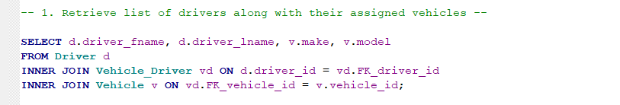
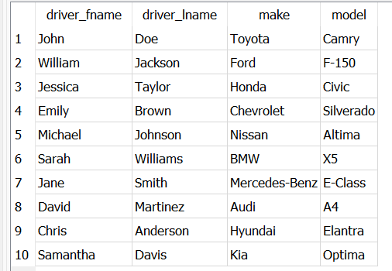
SQL Examples
Retrieve the list of drivers along with their assigned vehicles.
Join three tables: Driver, Vehicle_Driver and Vehicle.
Can know how many drivers are associated with the company and what type of vehicles they are driving.

Slide 9
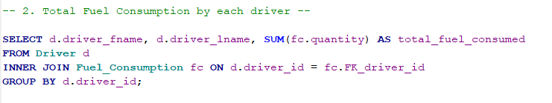
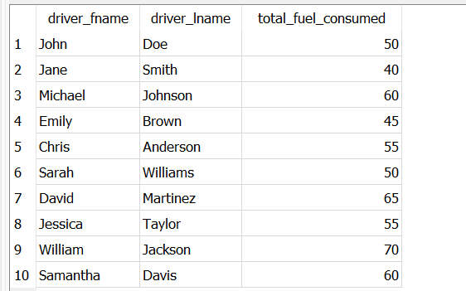
SQL Examples
Total Fuel consumption by each driver.
Join two tables: Driver and Fuel_Consumption.
Use group by with Driver's Id
Use aggregate function SUM() to calculate total fuel_consmpution.

Slide 10
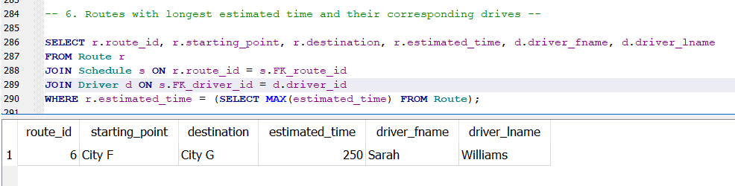
SQL Examples
Who take the maximum time for complete his delivery.
Join three tables: Route, Schedule and Driver.
Use sub query to find the maximum time.

Slide 11
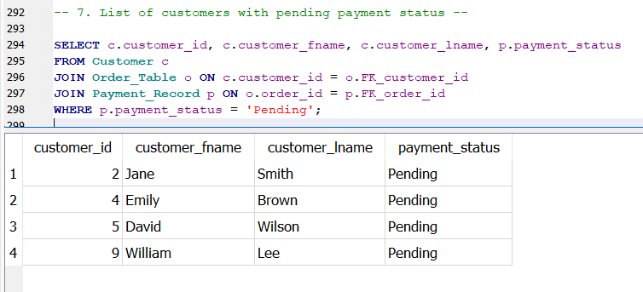
SQL Examples
List of customer with pending payment status.
Join Customer, Order and payment record tables.
Filter out the customer with pending payment status.

Slide 12
Metrics and Analytics
There are total 10 drivers who are associated with company.
William Jackson drives Ford vehicle which consumed 70 liters fuel which is the highest fuel consumption among ten drivers.
Sarah William took 250 minutes to complete his delivery from City F to City G.
Only four customers are there with pending payment status.

Slide 13
Security and Privacy
Customer, Driver, Insurance Details, Payment records and order table contain sensitive data.
Unauthorized access to this information lead to privacy violations.
Robust security measures like access controls, encryption and authentication mechanism are necessary.
Regular security audits or checks should be implemented to detect and prevent unauthorized access.

Slide 14
Next steps / Lessons Learned
Proficiency in Business Analysis.
Mastery of ER Diagram Formulation.
Architecture Refinement.
Recognizing the importance of safeguard the sensitive data.
Will include live vehicle tracking function, broader user base and enhance usability and scalability.
Also implement the route optimization algorithms.

Slide 15
Any Questions ?

Slide 16
Thank You !!!

